Slide 1

Classes & Objects

Slide 2
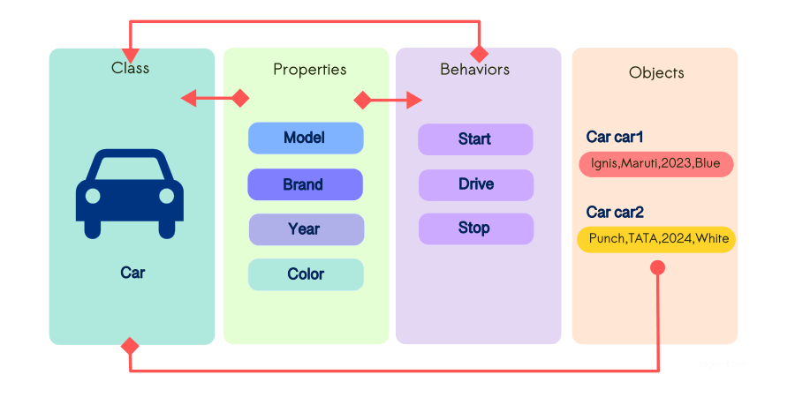
What is a Class?

Slide 3
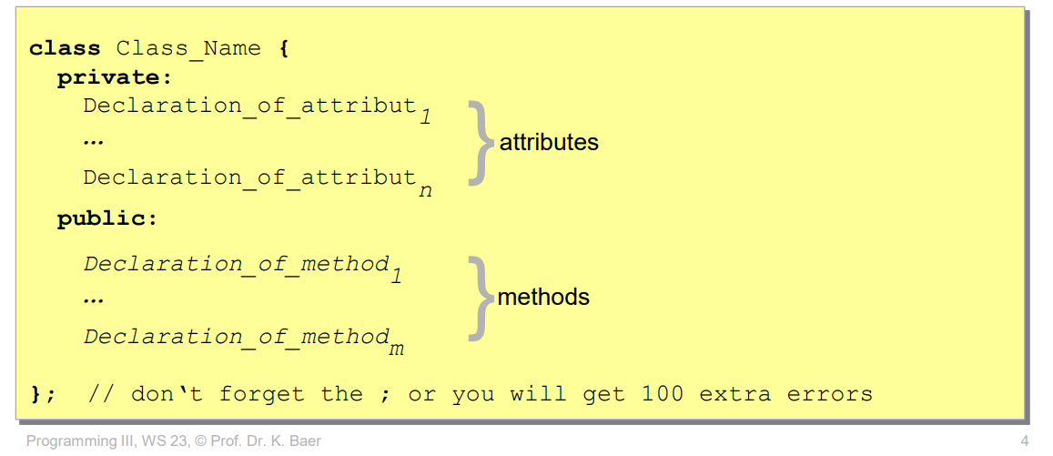

Slide 4
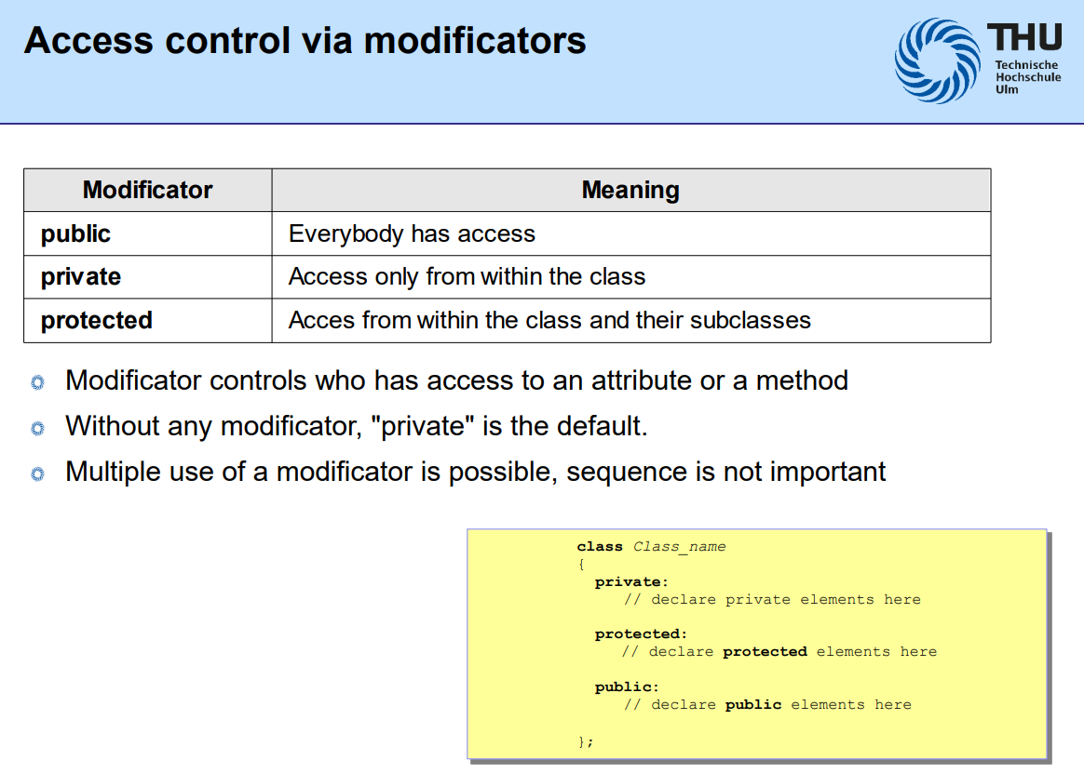

Slide 5
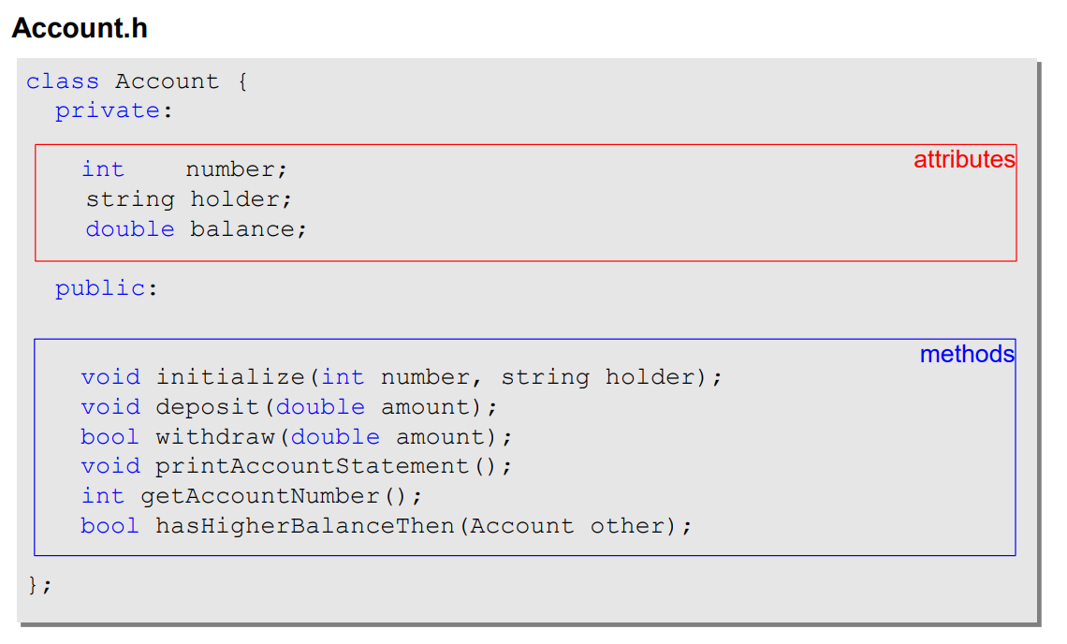
Example

Slide 6
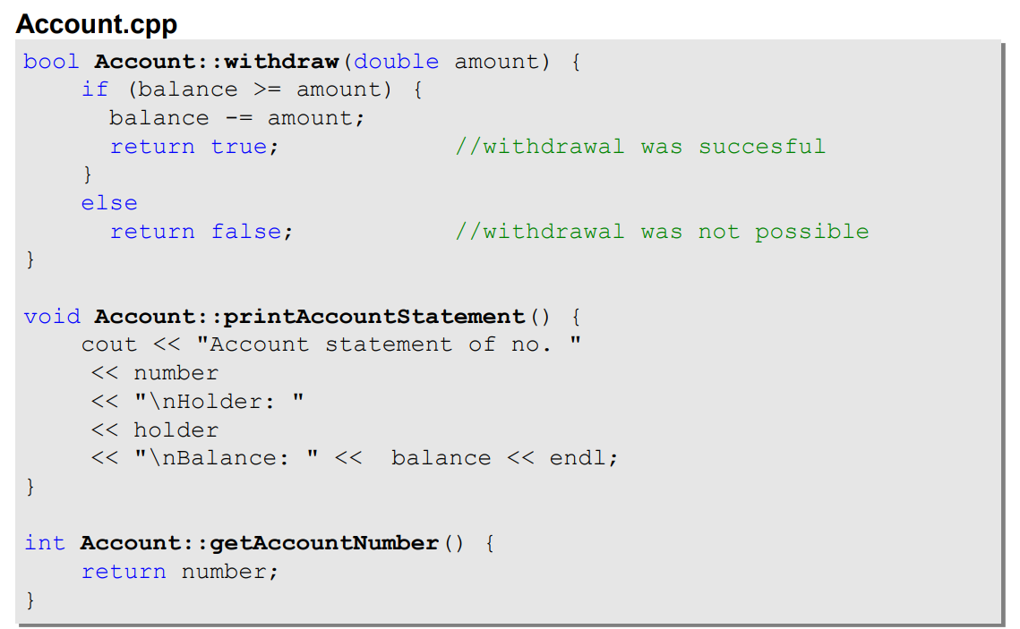

Slide 7
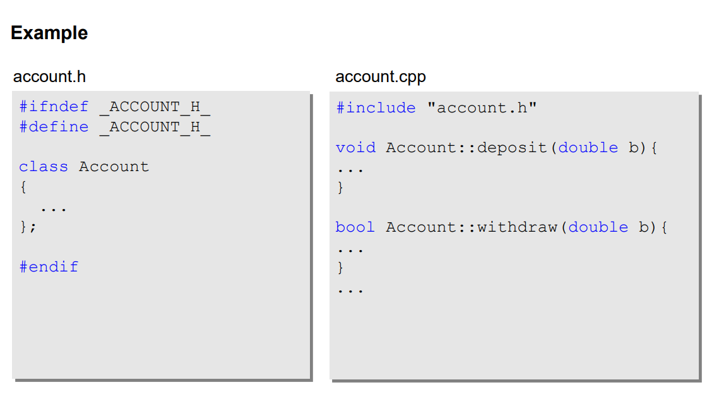
Modularity and Code Organization
Code Reusability
Linking Multiple Files

Slide 8
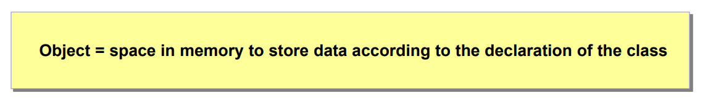
Objects

Slide 9
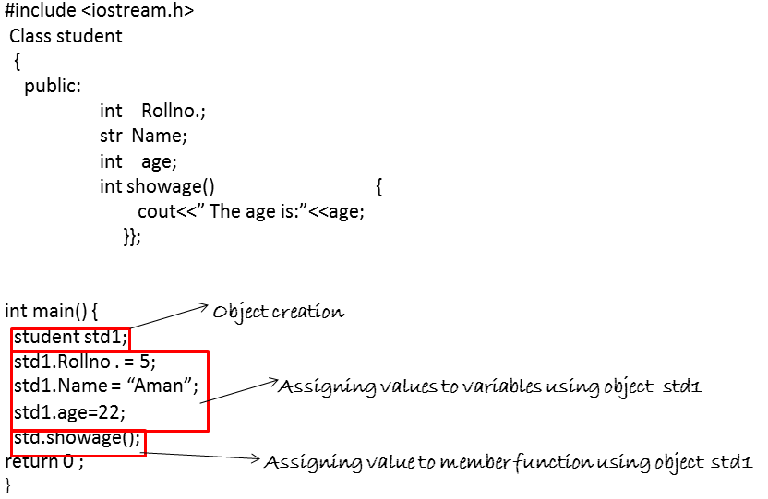
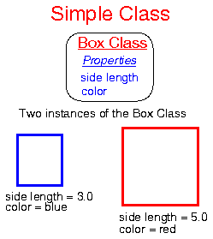
Why do we need them?

Slide 10
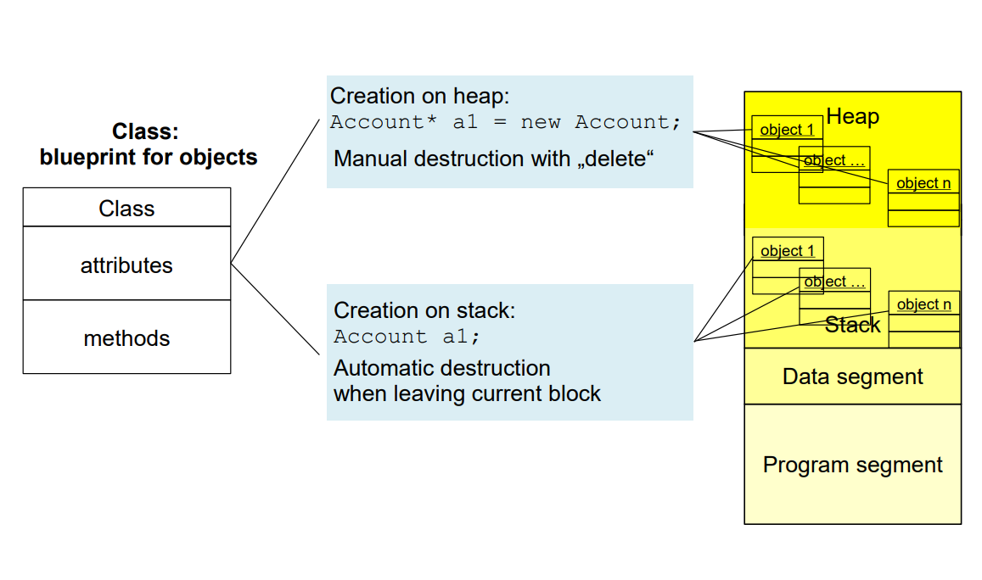

Slide 11

Special Pointers “this”

Slide 12
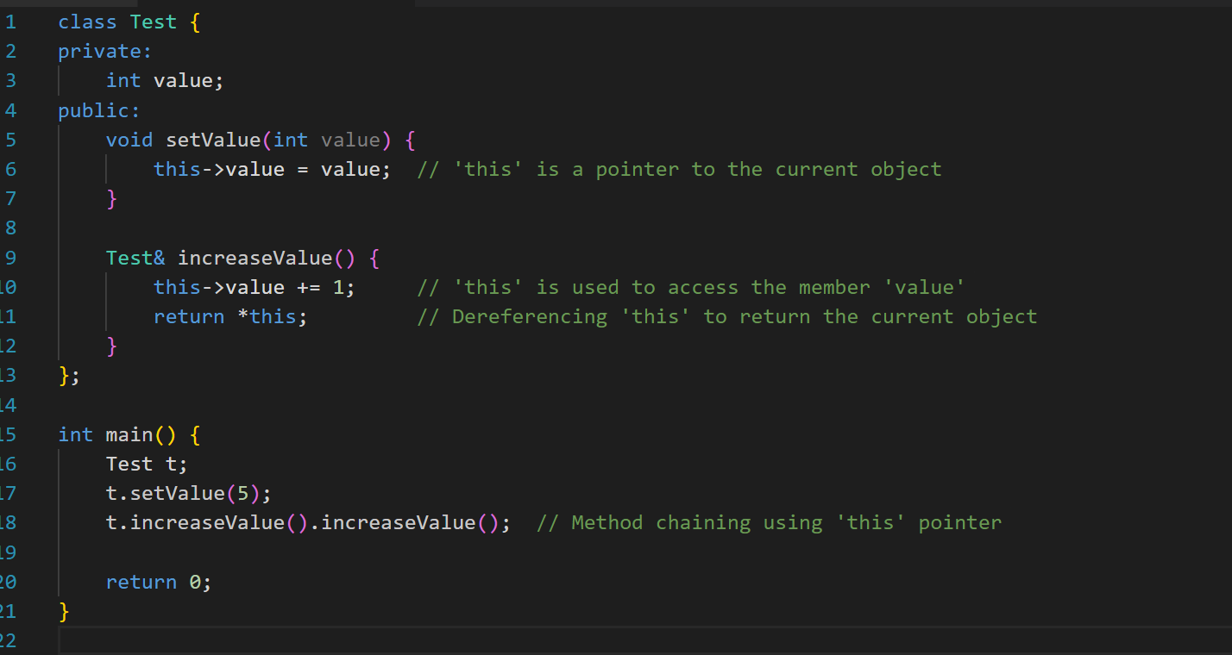
What is meaning of the keyword “this”?
“this” keyword represents a constant pointer that points to the current instance (object) of the class within which it is used.
It points to the current instance (object) of the class that is calling the method
Notes:
How it works:
When t.setValue(5) is invoked, the this pointer automatically points to t (the object calling the method).
Inside setValue, this->value modifies the value member of the object t.
The same thing happens when you call t.increaseValue(). The this pointer ensures that the method modifies the object t without needing to explicitly pass t into the method.

Slide 13
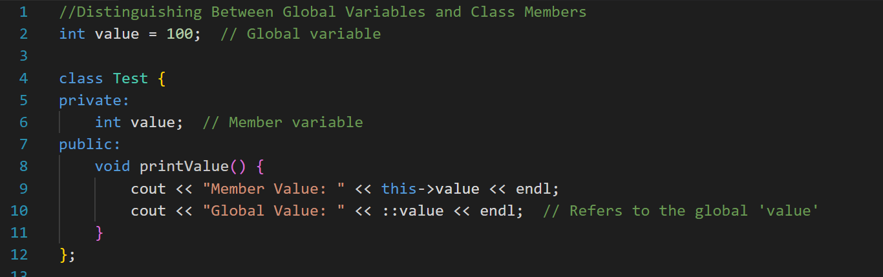
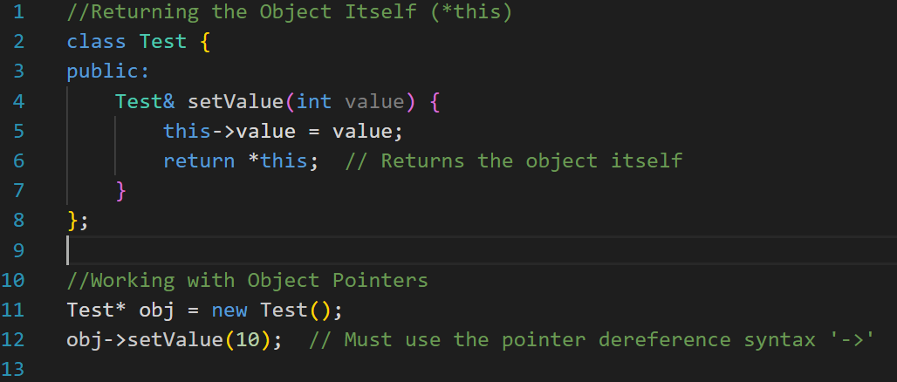
Why do we need them?
Notes:
Conclusion:
You don't always need to use this->, but it is essential in cases of naming conflicts, method chaining, clarity, or working with pointers. It ensures that you're correctly referring to the current object's members. In simpler methods with no conflict, you can omit it, but this is an important tool to handle more complex situations efficiently.
3. Returning the Object Itself (*this)
Sometimes, you want to return the current object from a method (useful for method chaining). Since this is a pointer to the object, you can dereference it (*this) to return the object itself.
Without this, you wouldn’t be able to return the current object in this way.
4. Working with Object Pointers
If you're working with pointers to objects, you must use this to access member variables and functions, because you don’t have direct access to the object, only through a pointer.
Inside setValue(), this is the pointer to the object (obj), and you use this->value to access the member variable.
When You Don’t Need this->:
No Naming Conflict: If there’s no local variable with the same name, you can just access the member variables directly without using this->.
void setValue(int v) {
value = v; // No need for 'this->' if there's no conflict
}

Slide 14
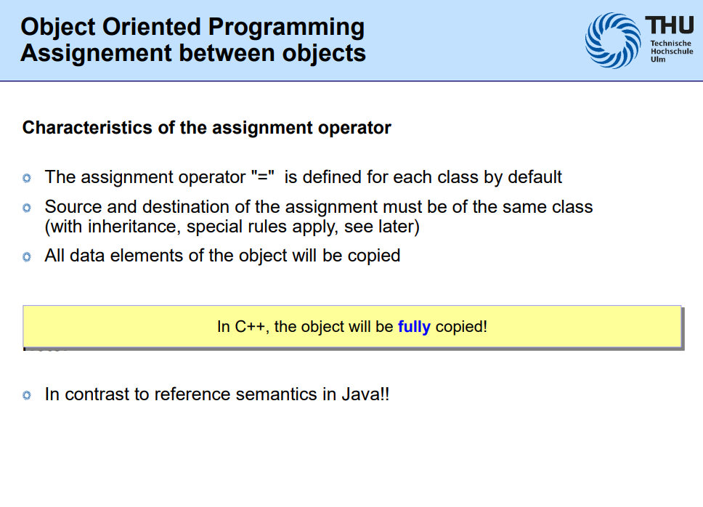

Slide 15
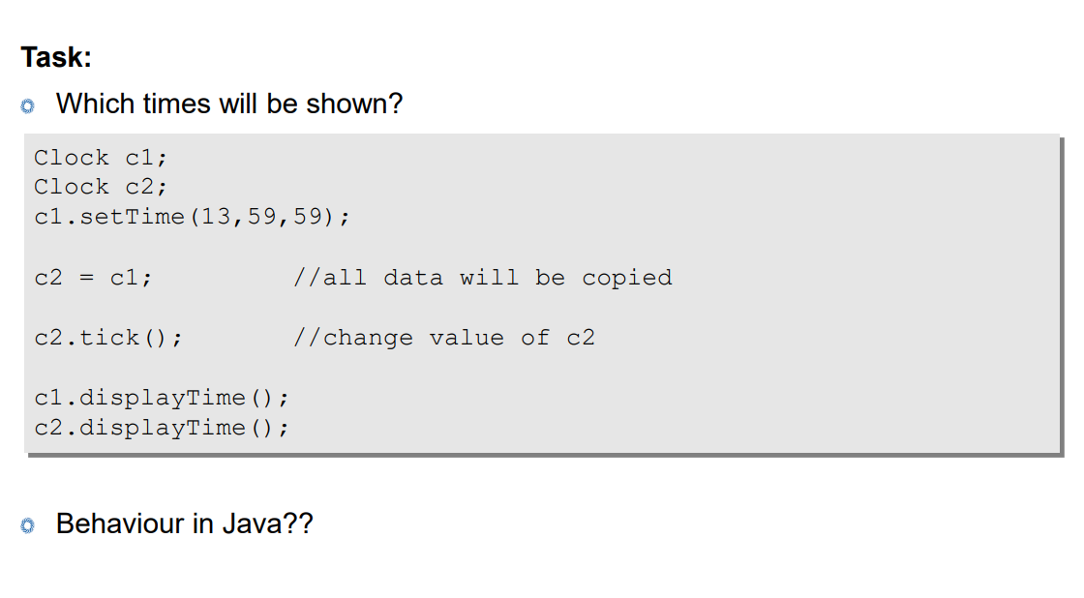

Slide 16
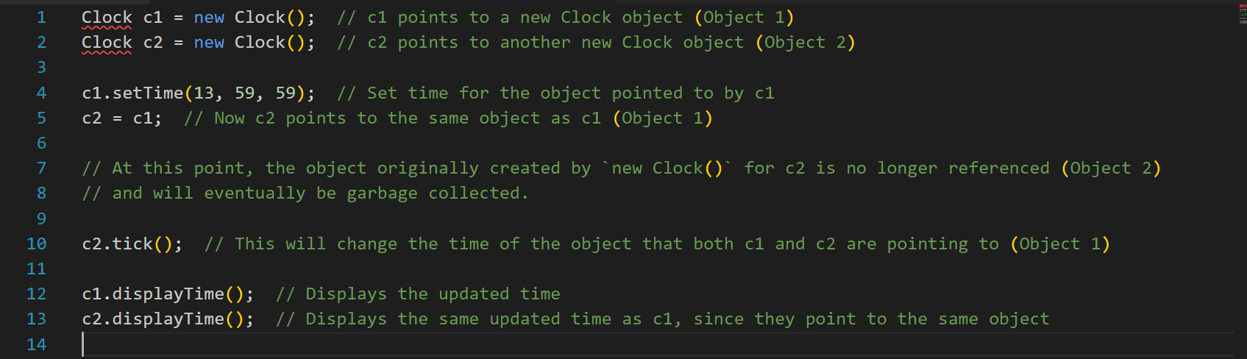
Notes:
Conclusion:
After c2 = c1;, both c1 and c2 are pointing to the same object in the heap.
The original object that c2 was pointing to before the assignment is no longer referenced and becomes eligible for garbage collection.
Java’s garbage collector automatically handles memory management, so there’s no need to manually delete objects.

